Slide 1



Slide 2

HCI project Report presentation
Team Members: [ Group # 03 ]
Zeeshan Javed ( SE - 211067 )
Huzaifa Khalid ( SE - 211102 )
Hanzalah Irfan ( SE - 211090 )

Slide 3

Yale school of Art
Contents:
Introduction
Scope
Review
Analysis
Evaluation
Conclusion

Slide 4
INTRODUCTION
The Yale School of Art is the art school of Yale University. Founded in 1869 as the first professional fine arts school in the United States, it grants Masters of Fine Arts degrees to students completing a two-year course in graphic design, painting/printmaking, photography, or sculpture.

Slide 5
Scope
Artists and designers of unusual promise and strong motivation are provided an educational context in which they can explore the potential of their own talents in the midst of an intense critical dialogue. This dialogue is generated by their peers, by distinguished visitors, and by a faculty comprised of professional artists of acknowledged accomplishment.
The graduate students primary educational experience at Yale is centered on the students own studio activity. Supporting this enterprise are the experience, knowledge, and skills gained from rigorous, structured courses such as drawing, filmmaking, the relativity of color, and the rich academic offerings found throughout Yale. Each student is routinely exposed to many aesthetic positions through encounters with faculty members and visitors. The School is devoted not only to the refinement of visual skills, but also to the cultivation of the mind. Students must bring creative force and imagination to their own development, for these qualities cannot be taught— they can only be stimulated and appreciated.
The School of Art offers an undergraduate art major for students in Yale College (see the bulletin Yale College Programs of Study). In addition, the School courses are open to students in the Graduate School of Arts and Sciences and other professional schools of the University, and School of Art students may enroll in elective courses in the Graduate School and other professional schools as well as in the College with permission.

Slide 6
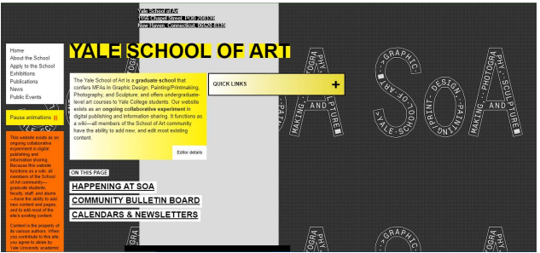
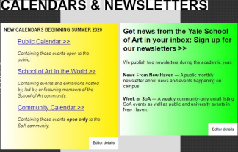
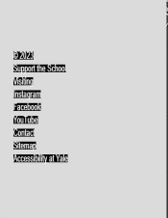
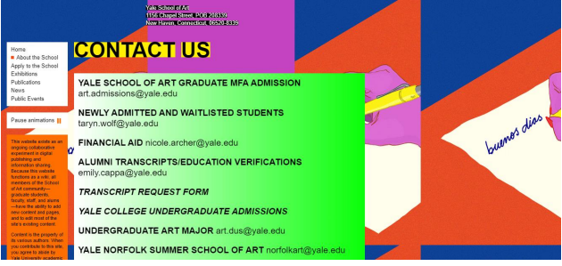
Review
Elements and Features that were not well designed
Navigation Bar
Calendars and Newsletters
Footer
Alignment
Background Design
Contact us page

Slide 7
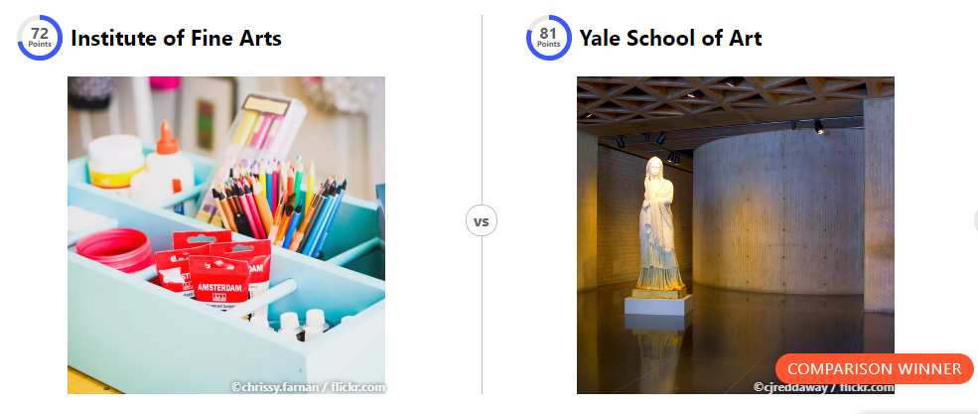
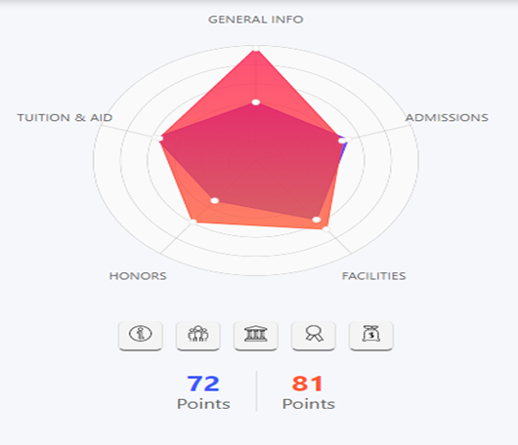
Review
Yale School of Art VS Institute of Fine Arts

Slide 8
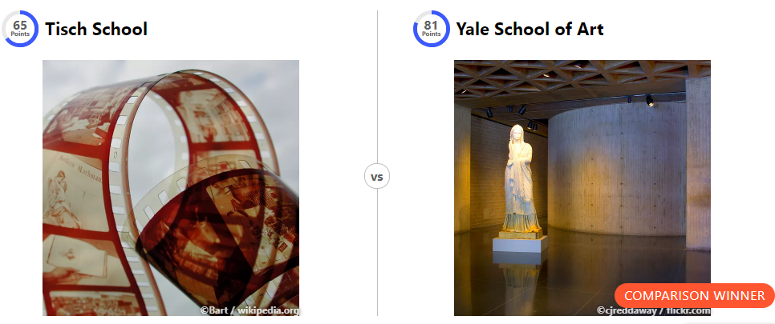
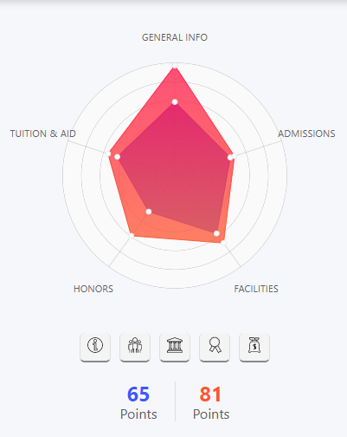
Review
Yale School of Art VS Tisch School

Slide 9
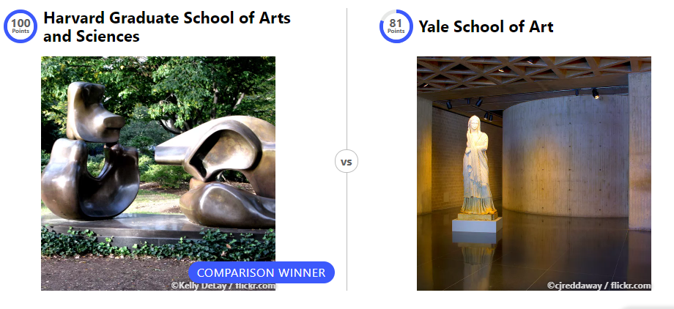
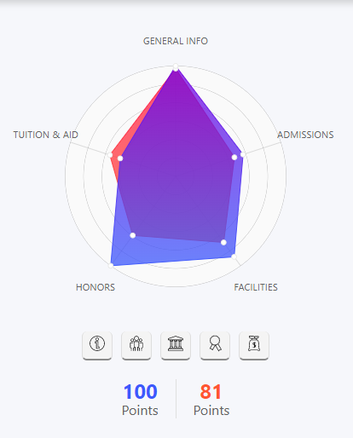
Review
Yale School VS Harvard School

Slide 10
Review

Slide 11
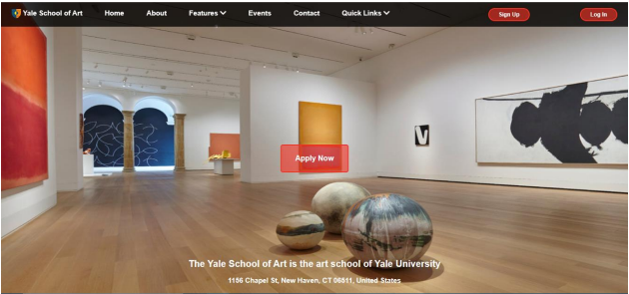

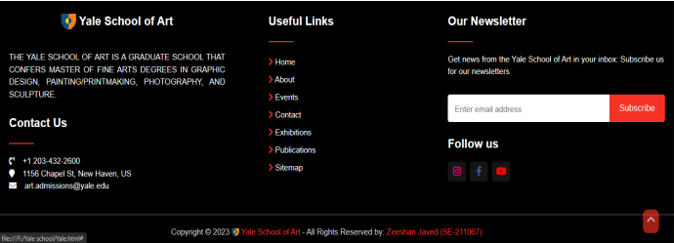
Analysis

Slide 12
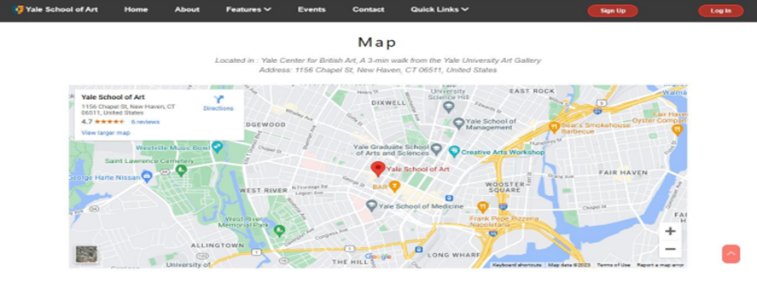
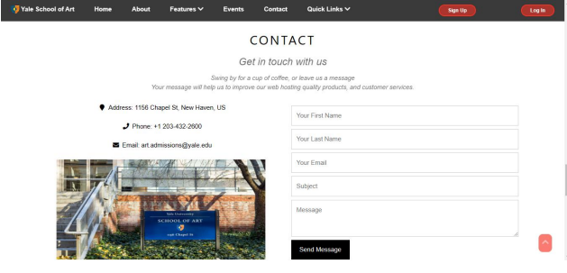
Analysis

Slide 13
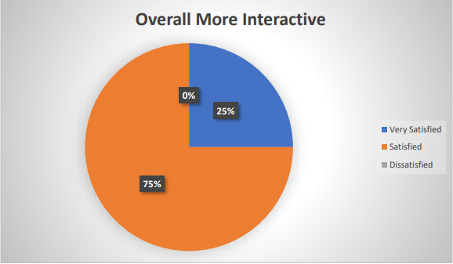
Analysis
Our Team Website Interactive Pie Chart:

Slide 14
Evaluation
User based
Psychological based
Laboratory based

Slide 15
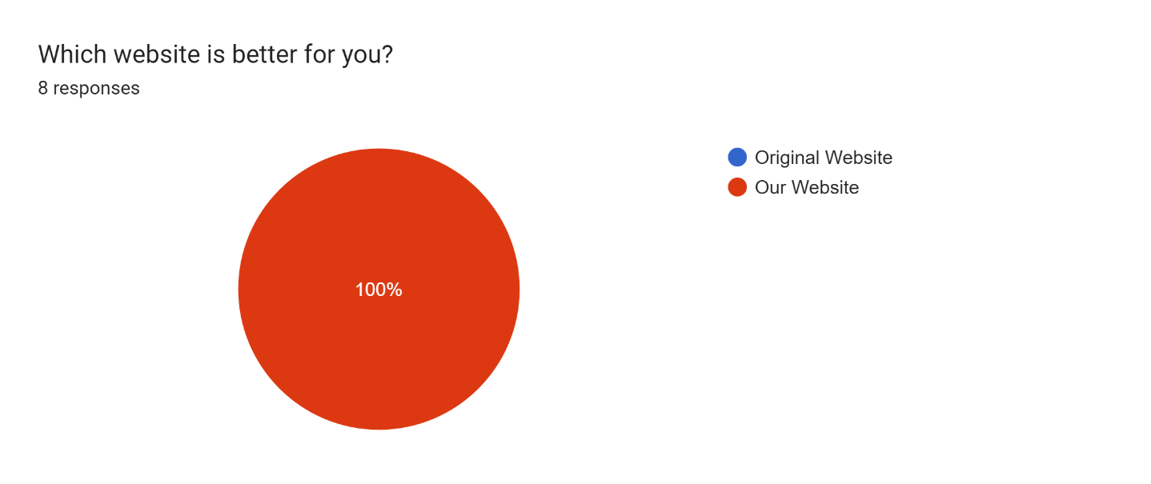
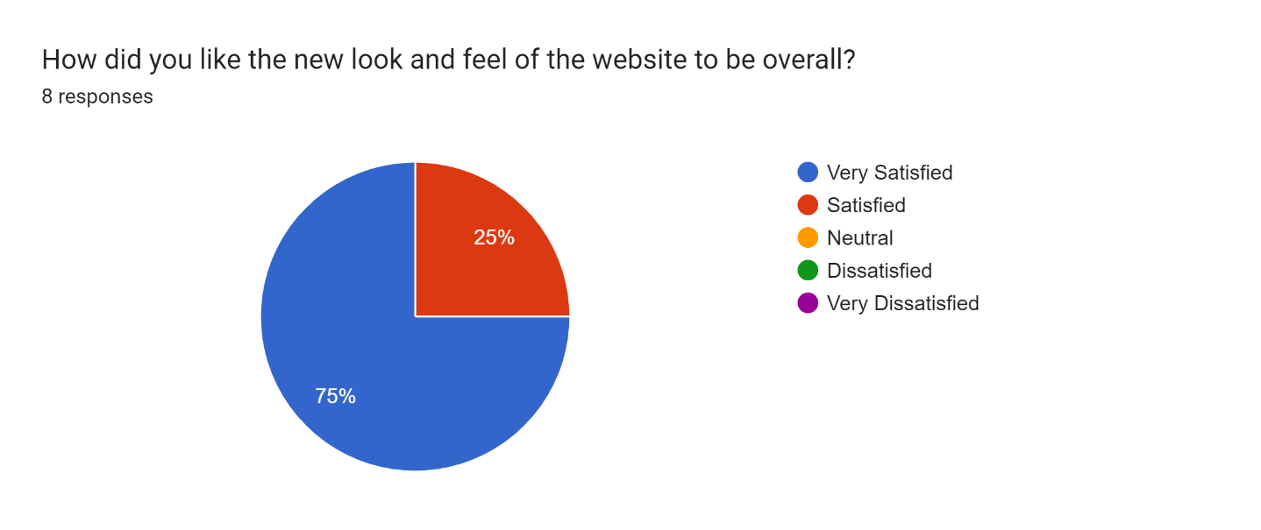
User Based ( Survey Questionaries )

Slide 16
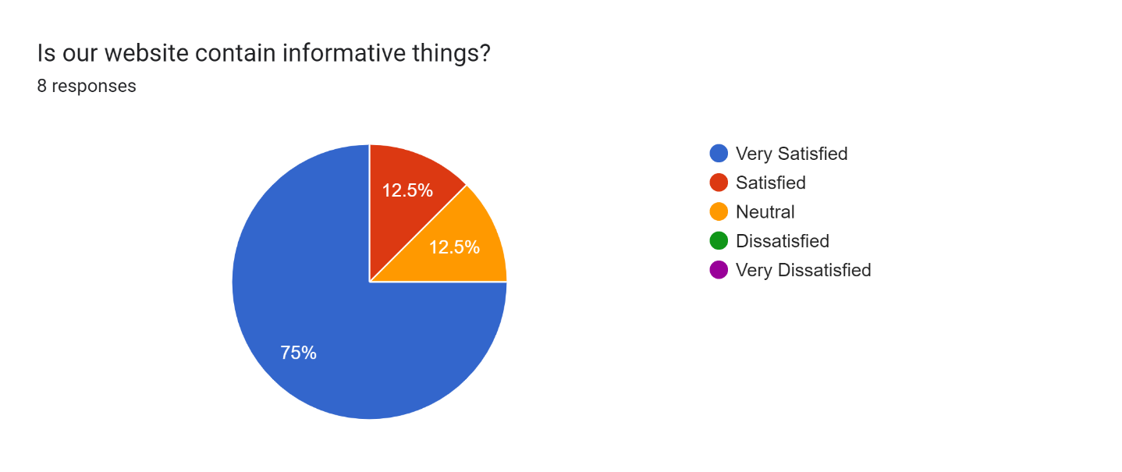

User Based ( Survey Questionaries )

Slide 17
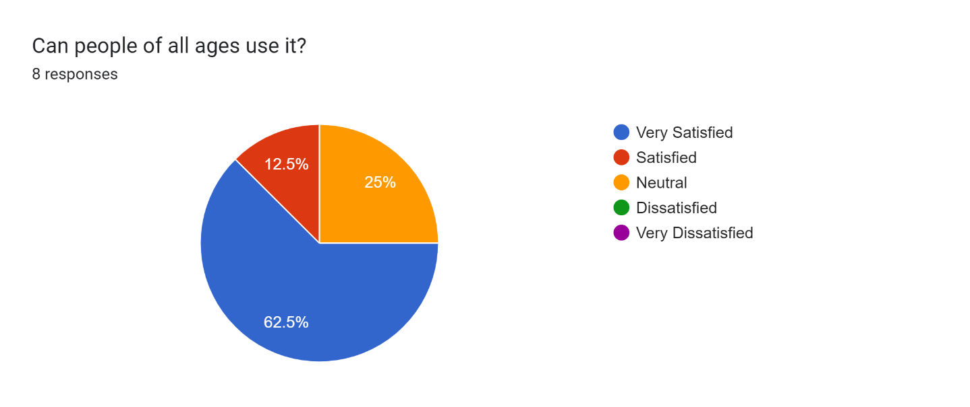
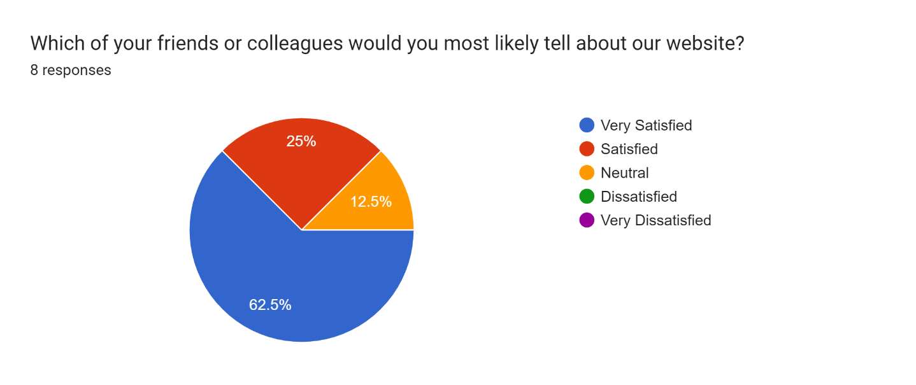
User Based ( Survey Questionaries )

Slide 18
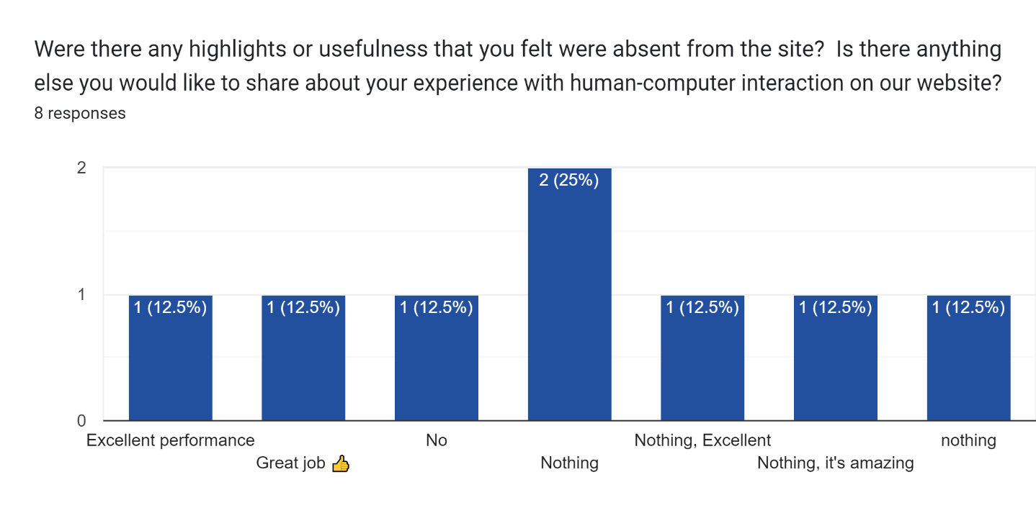
User Based ( Survey Questionaries )

Slide 19
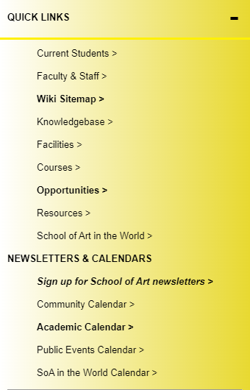
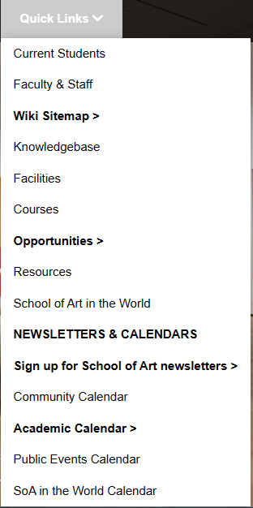
PSYCHOLOGICAL BASED
Original Website
Our Team Website

Slide 20
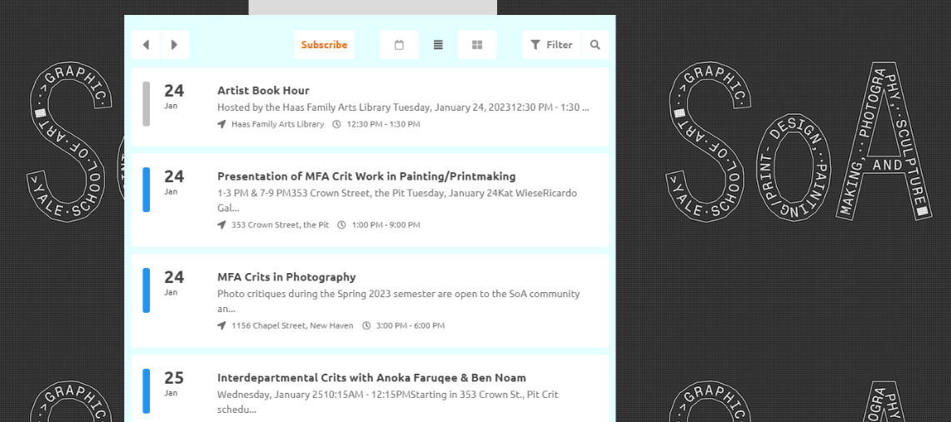
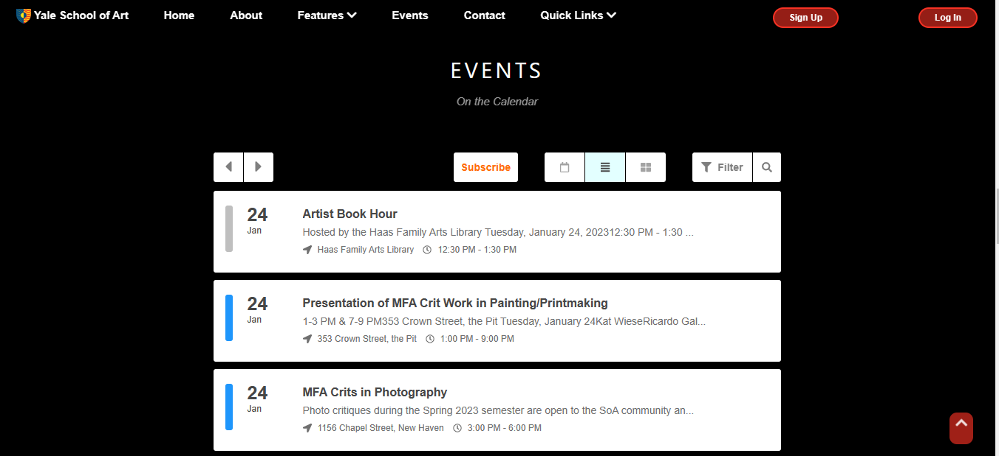
PSYCHOLOGICAL BASED
Original Website
Our Team Website

Slide 21
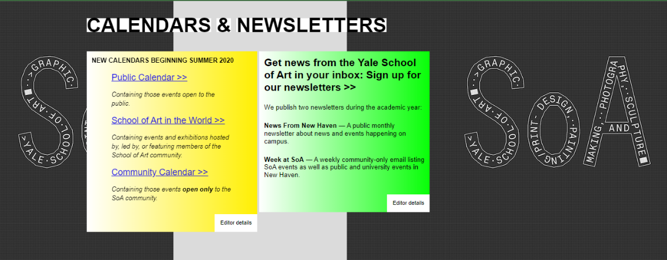

PSYCHOLOGICAL BASED
Original Website
Our Team Website

Slide 22


PSYCHOLOGICAL BASED
Original Website
Our Team Website

Slide 23
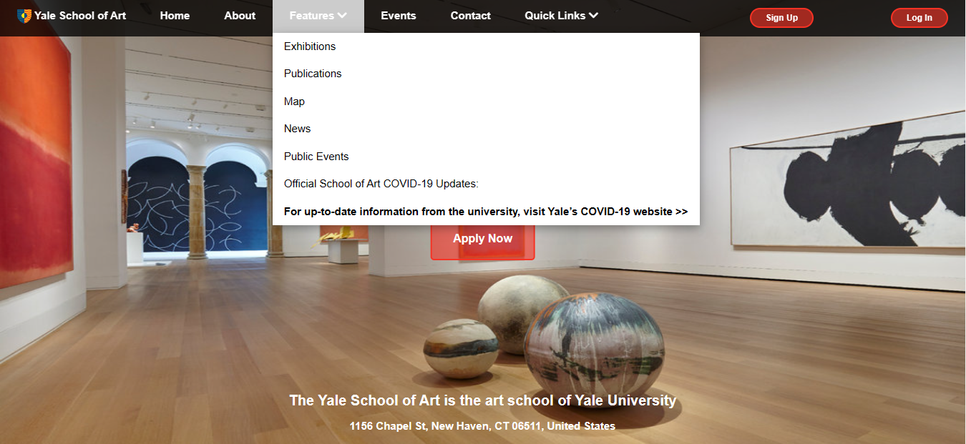
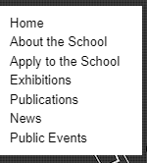
PSYCHOLOGICAL BASED
Original Website
Our Team Website

Slide 24
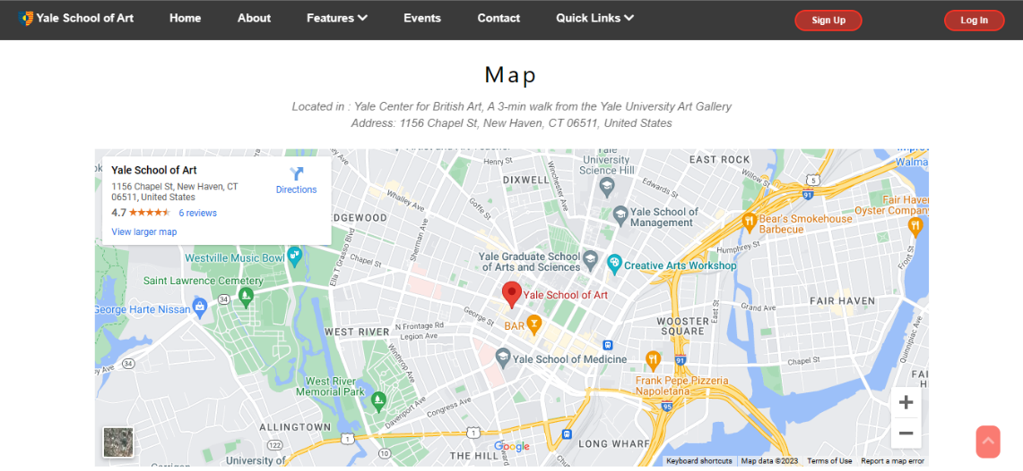

PSYCHOLOGICAL BASED
Original Website
Our Team Website
Not included both of them.

Slide 25
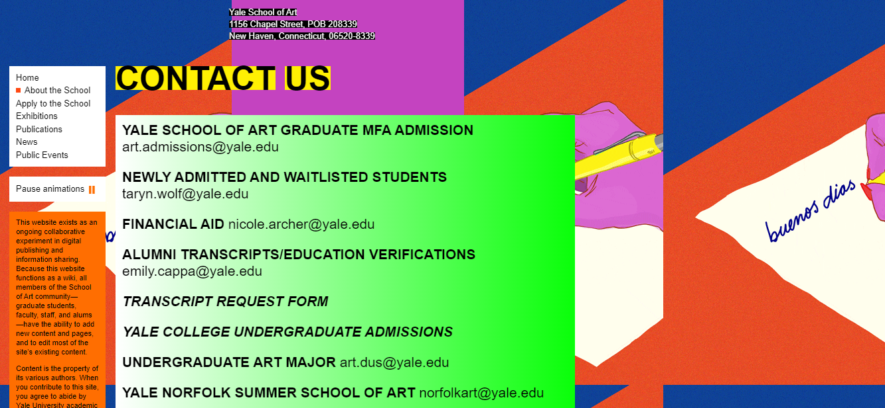
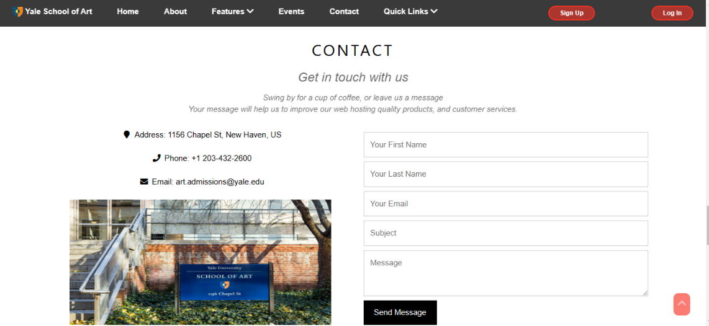
PSYCHOLOGICAL BASED
Original Website
Our Team Website

Slide 26
Laboratory based
Original Website Report:
Social: --------------------------->Yes (96%)
Mobile Friendly: -------------->Yes (100%)
Video: --------------------------->Not detected
Images: -------------------------> Optimized
Amount of Content: --------> 5,028 words on 5 pages
Local: --------------------------->Yes (97%)
Website build: ---------------->Yes (88%)
Organic Search: --------------> Yes (94%)
Search terms:
(yale, yale university, henry winkler, confidence interval, dyslexia)
Paid Search: ------------------->Found (100%)
Paid keywords:
(project management certification, online business courses, international businesses, project management courses, business intelligence course)

Slide 27
Conclusion
Overall, the Yale School of Art website appears to be unstructured and difficult to navigate. The layout is not clear and not organized, and it is very difficult to find information on the various programs and resources offered by the school. In this case our team changed this website into a better website and our website appears to be structured and easy to navigate as well as the layout is very clear and organized and also our website help us to find information on the various programs and resources offered by the school. So, our team learned this project i.e. Human-computer interaction (HCI) is a crucial area of study in the field of computer science and engineering, as it deals with the design and development of computer systems that are easy to use and understand for human users. The ultimate goal of HCI is to create systems that are intuitive, efficient, and satisfying for users, and that can improve the quality of their interactions with technology. Overall, HCI is an interdisciplinary field that draws on concepts and methods from computer science, psychology, sociology, and other fields to create effective and user-centered systems.

